Slide 1
Hoot Interactive
Google VLA Assist Guide

Slide 2
Outline Of Set-Up Requirements
Create Advertiser & Set-up Custom Feed Inside Hoot Interface
Create or Obtain Access to Google Merchant Center
Link Merchant Center and Google My Business Location
Link Merchant Center and Google Ads Account
Create Local Ads Campaign (Link Included)

Slide 3
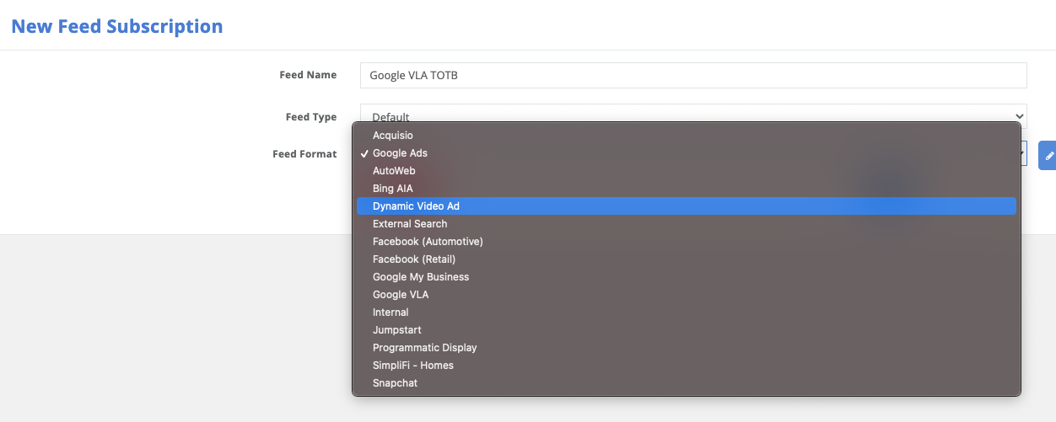
Create Custom Feed
Navigate to Inventory Feeds Tab
+ Feed Subscription
Name the Feed
Type = Default
Feed Format = Google VLA

Slide 4
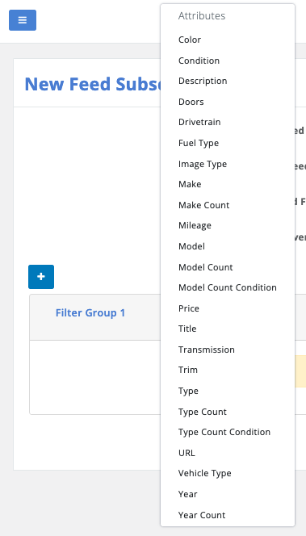
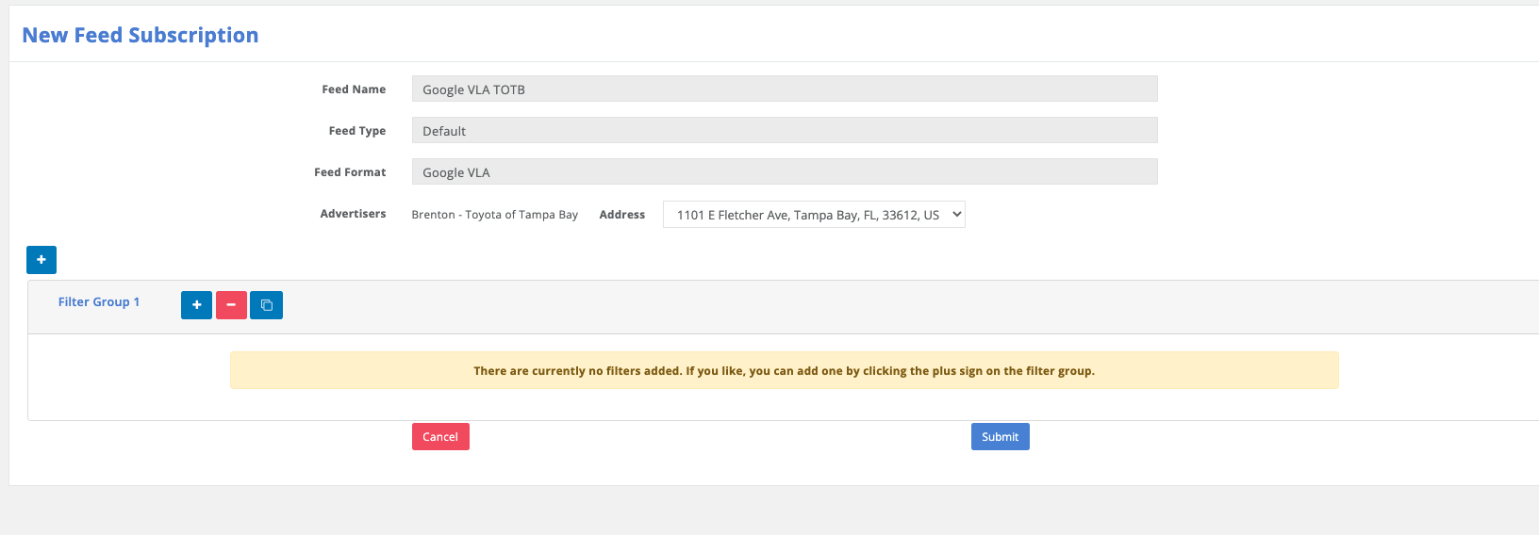
Create Custom Feed
Select the advertiser
Add any URL tracking Parameters needed
VLA Requires appending the store code parameter to the final URL. So you must include a tracking parameter named “Store” with a value of “"{store_code}”
Add Custom Filters if Necessary
We recommend Price >=1(Removes cars with no prices)

Slide 5
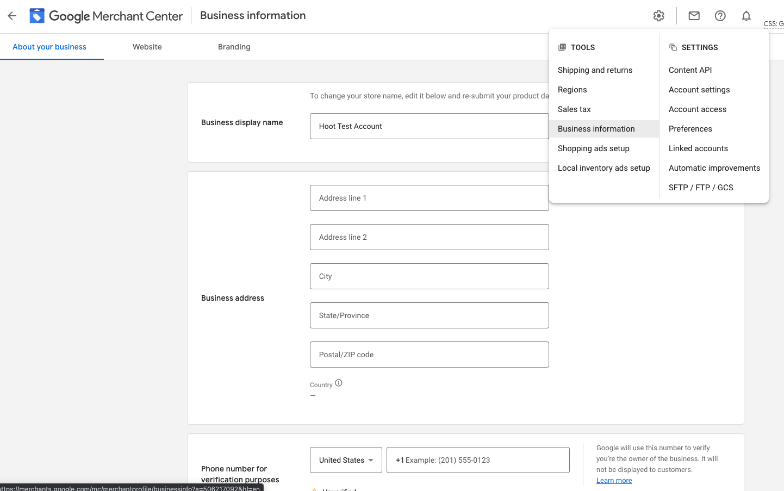
Google Merchant Center
Make Sure Business Information has been completed and URL is claimed
URL Must be claimed for Feed to be approved https://support.google.com/merchants/answer/176793
Create Feeds
Navigate to Products
Feeds
”+” Add New Feed
Select Language
Select Destinations
Vehicle Inventory Ads

Slide 6
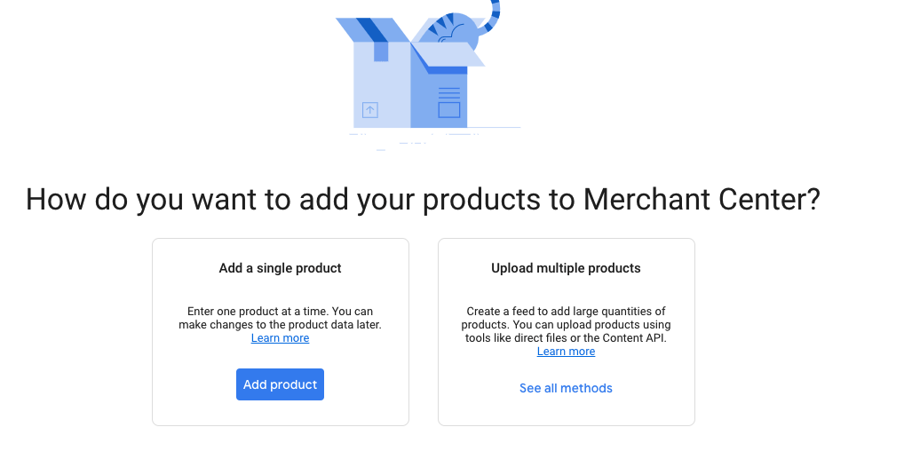
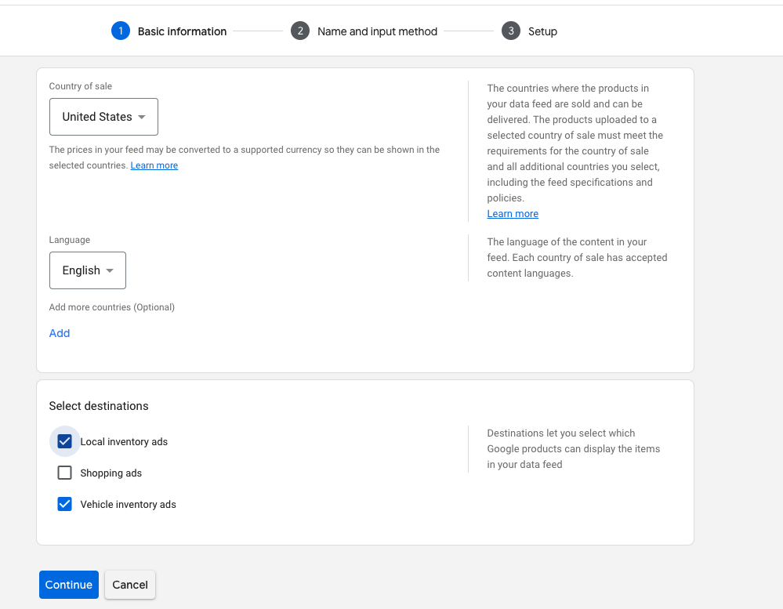
Merchant Center
Create and Activate your First Feed
Left Menu, Navigate to Product “Feeds”
“+” Create New Feed
You will be given an option on how you want to upload products, select “upload multiple products”
Select “vehicle Inventory Ads”
Continue

Slide 7
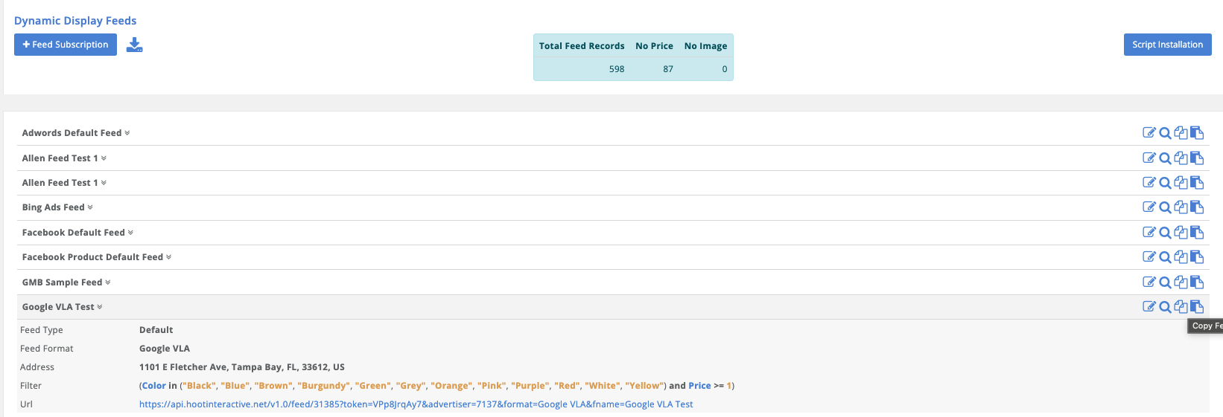
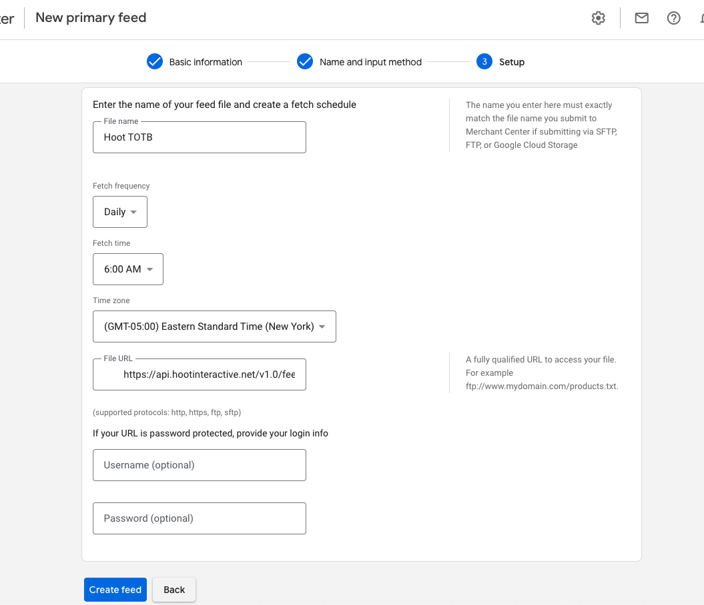
Merchant Center
Feed Creation
Give the file a name
Select frequency of feed upload
Copy and paste feed URL from Hoot Interface
Paste inside “File URL”
Username & Password not needed
Create Feed

Slide 8
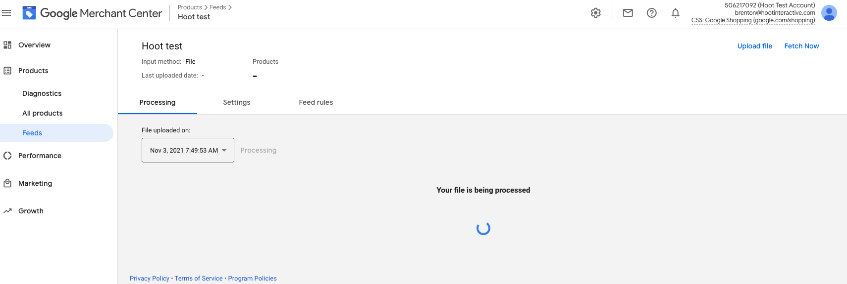
Merchant Center
Once Created click into the feed you just created
Top Right corner select “Fetch Now”
This will take a few minutes but should return some results
Fix any issues there might be present
Vehicles missing values can be filtered out at the feed level inside the Hoot interface.
The store code parameter is required and can be applied inside the Hoot interface.

Slide 9
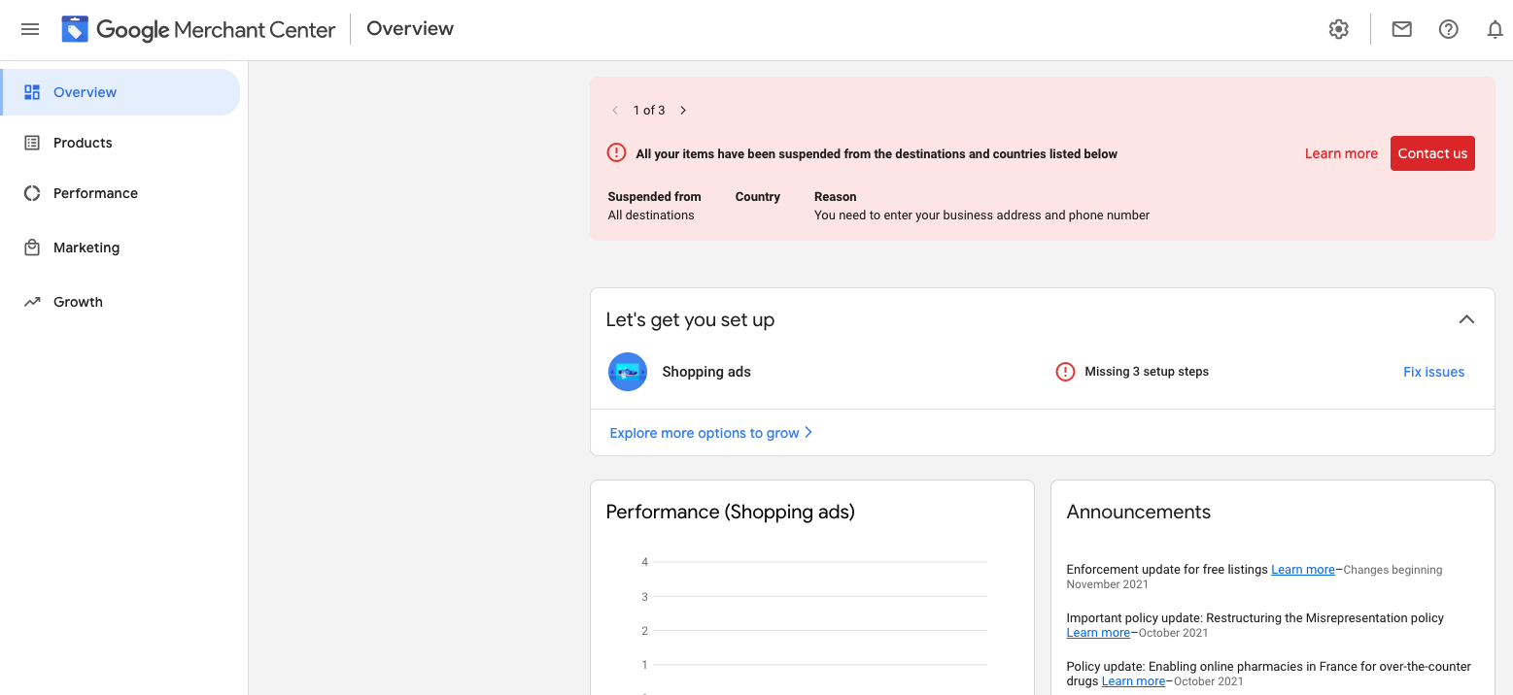
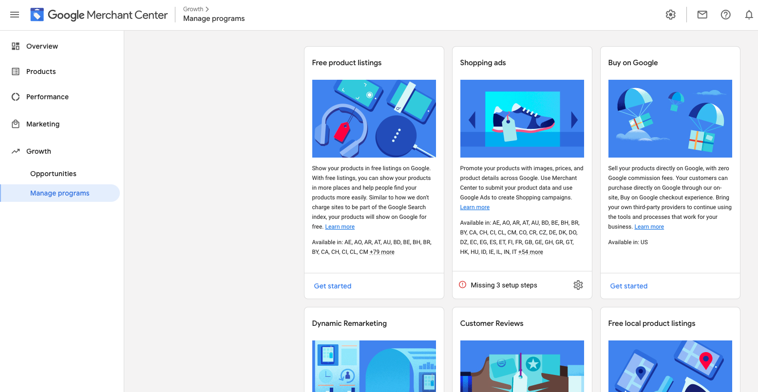
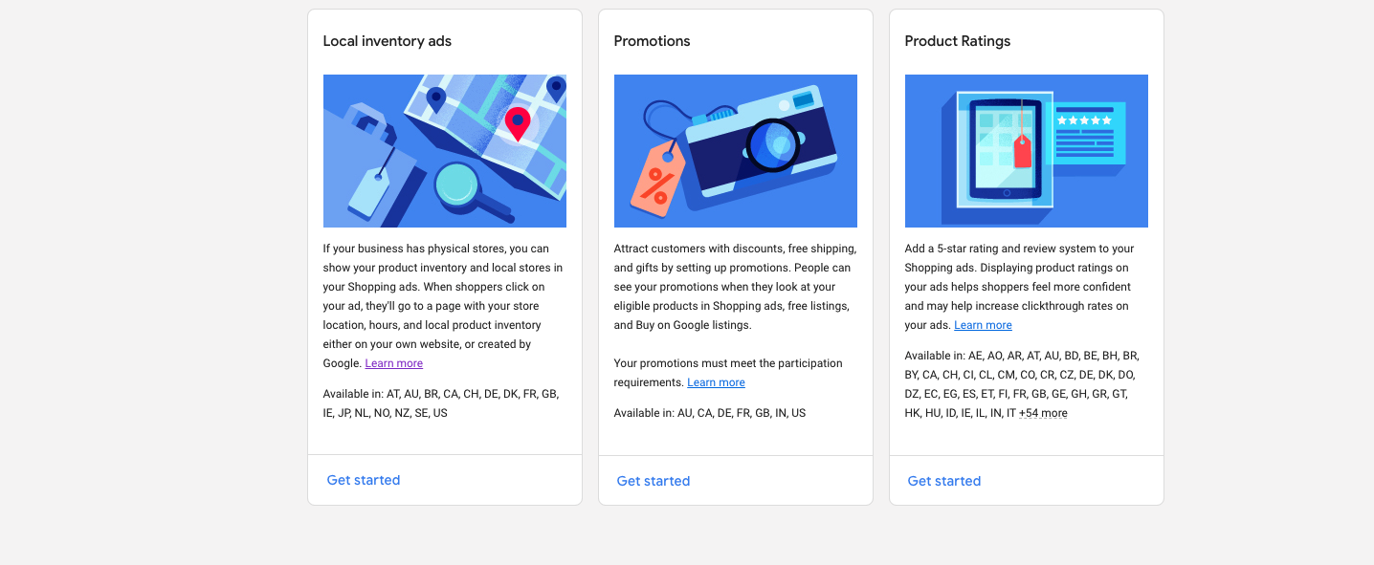
Google Merchant Center
Navigate to “Growth”
Select “Manage Programs”
Open “Local Inventory Ads”

Slide 10
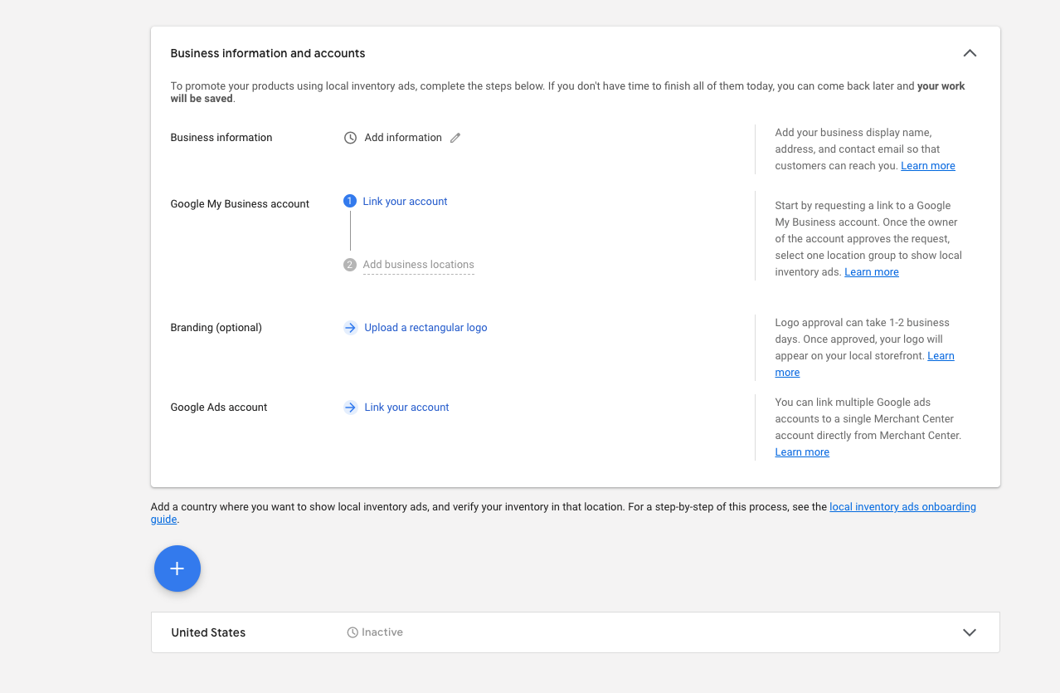
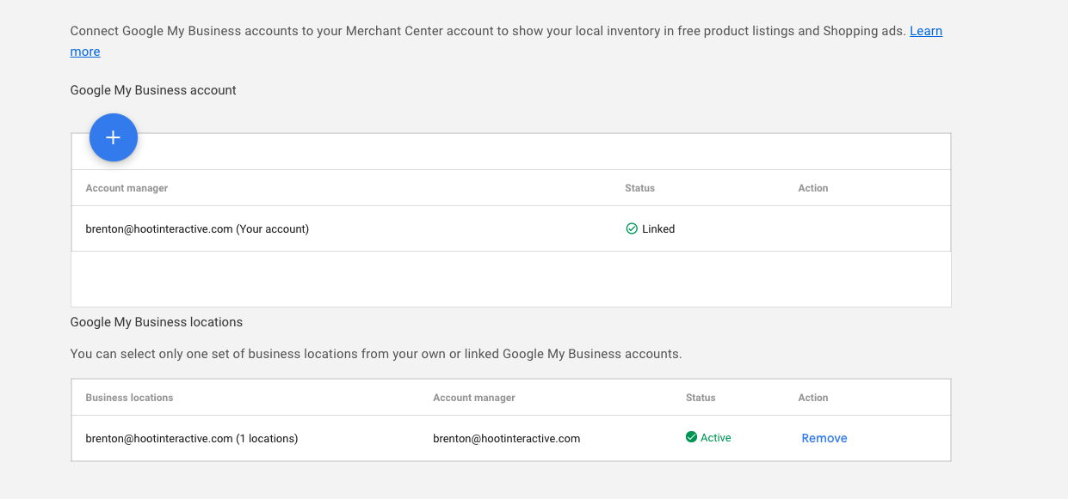
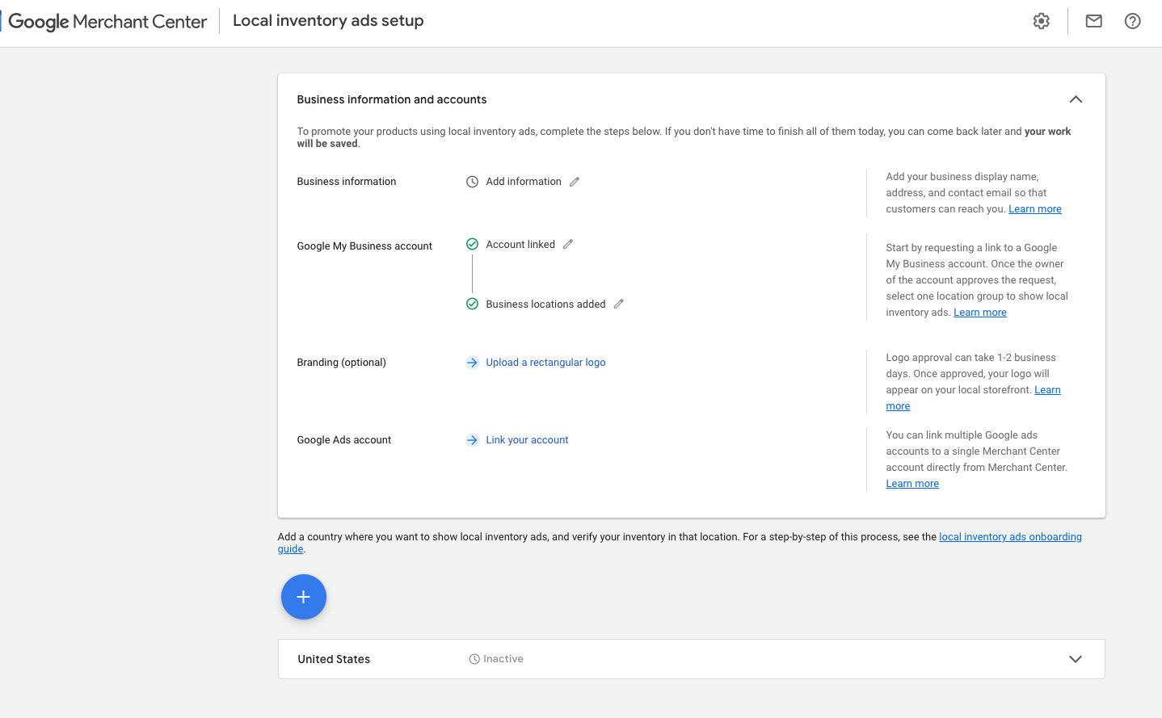
Google Merchant Center
It will ask you to pick your country
You Must Link to The Clients GMB Account
When you click into the add location it will list all locations you are set as a manager for
Select the location
Once approved, Google will show confirmation that it is now linked

Slide 11
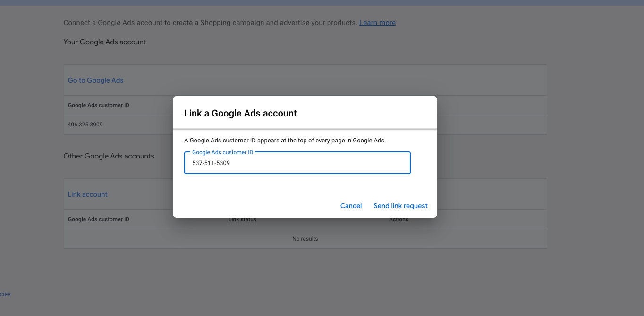
Google Merchant Center
Now You Must Link Google Ads Account
It will default to your MCC or you can add a manual request
If the account you want isn’t Shown in the tip box, open the request window under “Other Google Accounts”
Enter the CID and send request

Slide 12
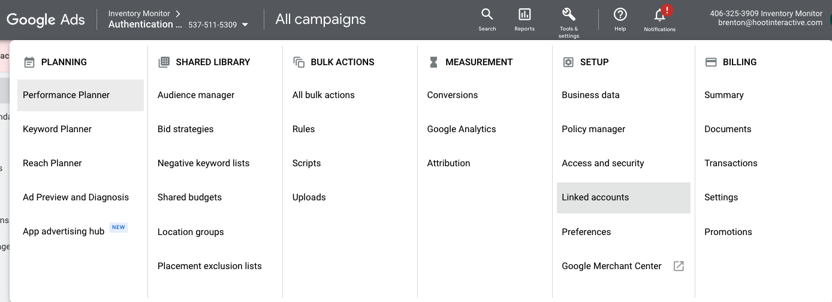
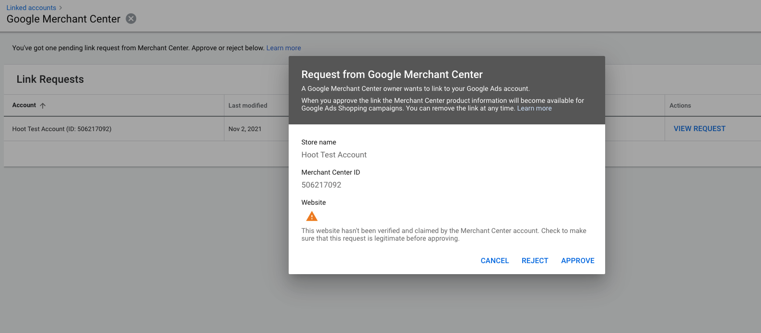
Google Merchant Center
Within Google Ads, Navigate to Tools & Settings and then “Linked Accounts”
You should see an open request
Open Request to approve
Once Approved it will show inside Google Ads as Linked

Slide 13
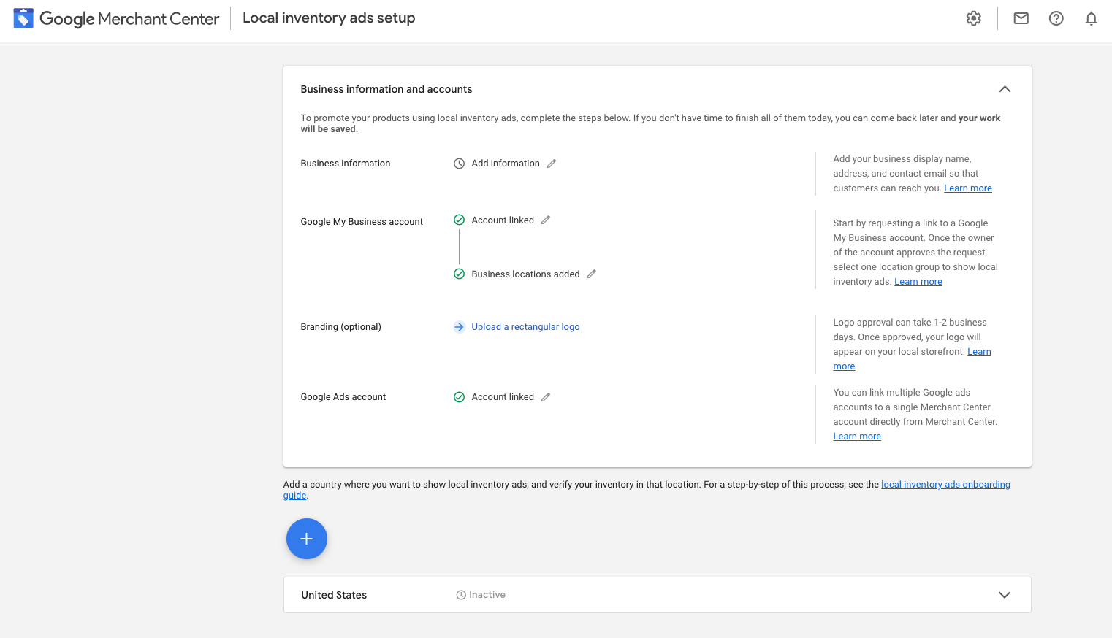
Google Merchant Center
Navigate back to merchant Center
You should now see that both the GMB and ADS account are linked
There is a link to the Ads Set-up Guide just below the box
https://support.google.com/merchants/answer/3540291?hl=en
Use the “+” to Start building out your first campaign

