Slide 1
Hoot Interactive
Google VLA Assist Guide

Slide 2
Outline Of Set-Up Requirements
Create Advertiser & Set-up Custom Feed Inside Hoot Interface
Update Google My Business Store Code
Add to Hoot interface(This is required)
Create or Obtain Access to Google Merchant Center
Link Merchant Center and Google My Business Location
Link Merchant Center and Google Ads Account
Request Merchant Center Vehicle Ads Approval From Google
Upload Feed and Await Google Approval
Finish Set-Up
Create Vehicle Ads Campaign (Link Included)

Slide 3
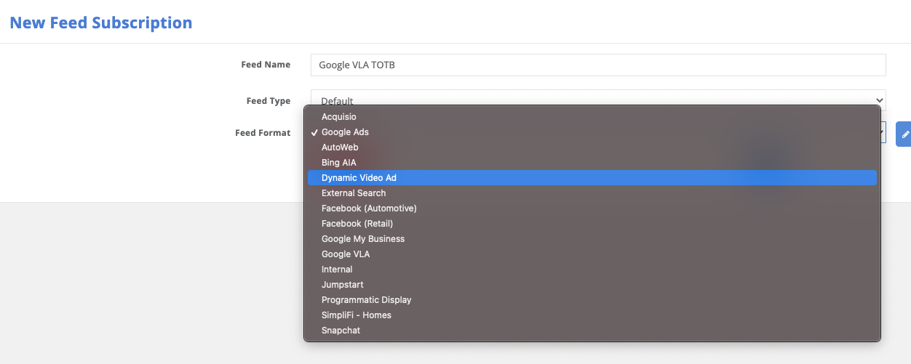
Create Custom Feed
Navigate to Inventory Feeds Tab
+ Feed Subscription
Name the Feed
Type = Default
Feed Format = Google VLA(Google Vehicle Ads)

Slide 4
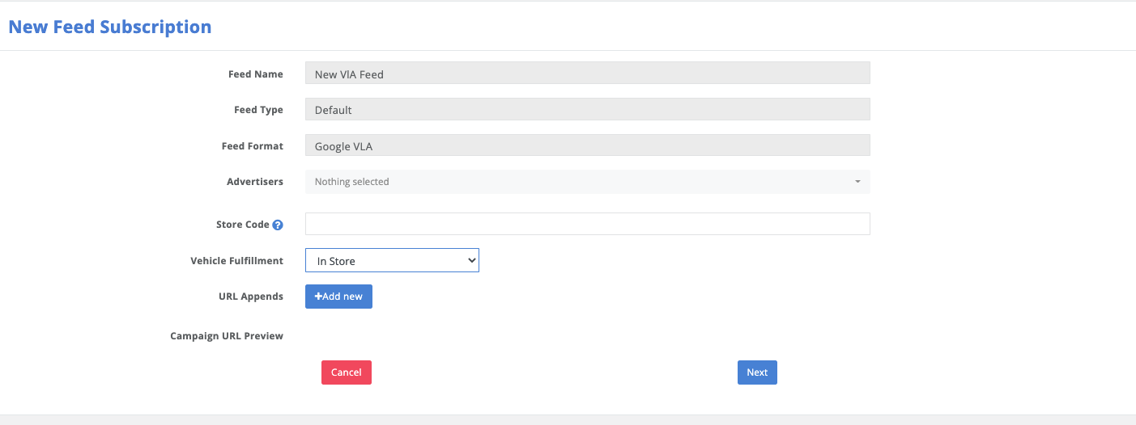
Create Custom Feed
Select the advertiser
Apply Store Code if not already set-up in client settings or if filtering out cars from a single location
Select Fulfillment Type – Defaults to “In Store”

Slide 5
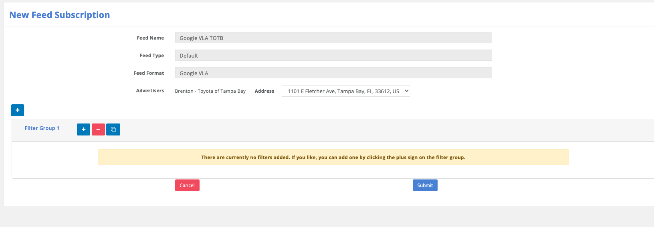
Create Custom Feed
Add Custom Filters if Necessary
We recommend Price >=1(Removes cars with no prices)
Remember cars with missing values will fail or alert as an error inside Merchant Center.
We try to pass all vehicle details that are available, but some filtering may be necessary to remove individual vehicle issues.

Slide 6
Merchant Center Account
Obtain Admin Access to Client Merchant Center Account
Or
Create New Merchant Center Account

Slide 7
Request Vehicle Ads Access From Google
Working with your dedicated Rep or Google Support you must request to have the Merchant Center activated to run ads Vehicle Ads Program
https://support.google.com/merchants/contact/vehicle_listing_ads?sjid=15056346231889401424-NA
This Step Must be done before a feed can be uploaded.

Slide 8
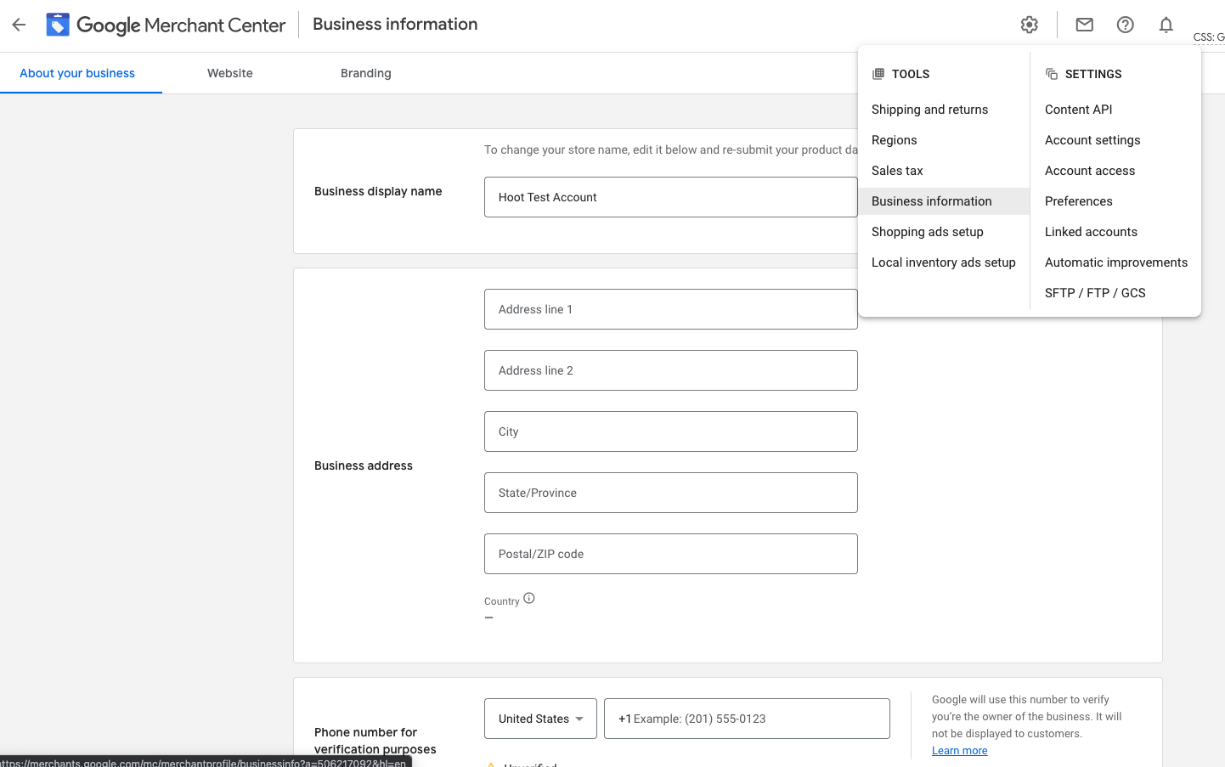
Google Merchant Center
Make Sure Business Information has been completed and URL is claimed
URL Must be claimed for Feed to be approved https://support.google.com/merchants/answer/176793
Create Feeds
Navigate to Products
Feeds
”+” Add New Feed
Select Language
Select Destinations
Vehicle Inventory Ads

Slide 9
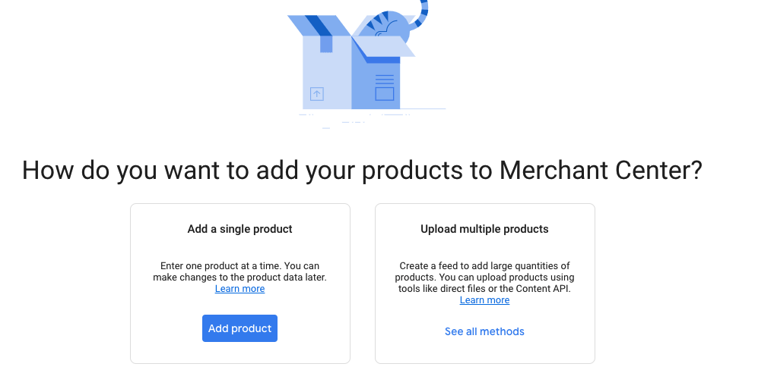
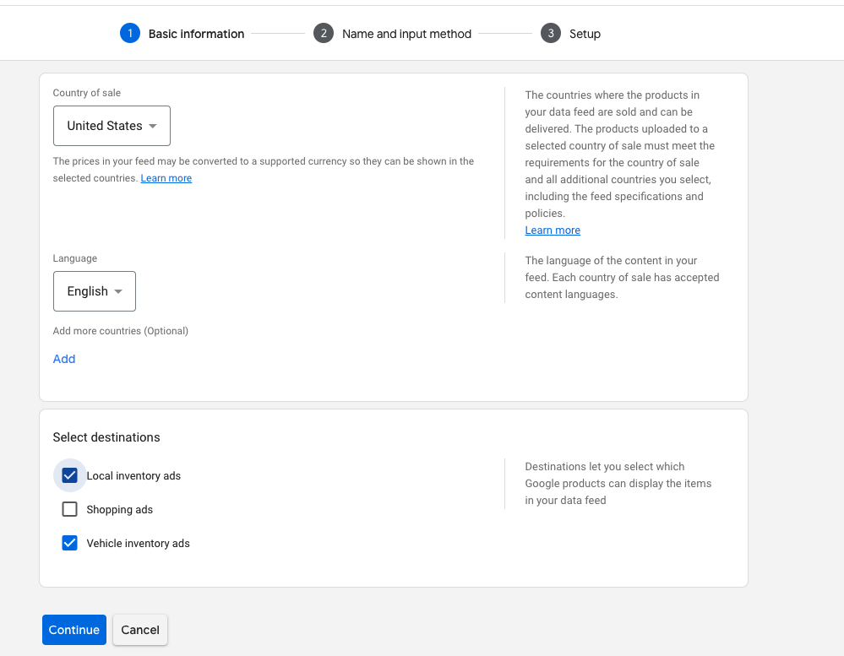
Merchant Center
Create and Activate your First Feed
Left Menu, Navigate to Product “Feeds”
“+” Create New Feed
You will be given an option on how you want to upload products, select “upload multiple products”
Select “vehicle Inventory Ads”
Continue

Slide 10
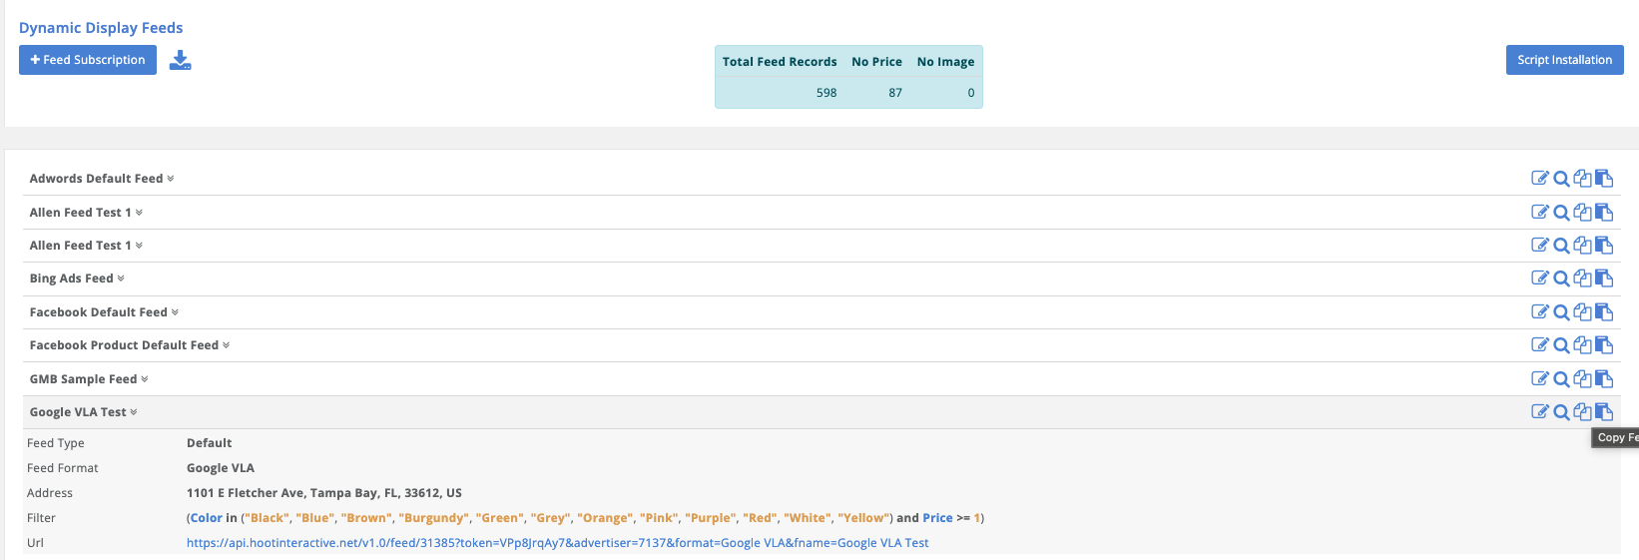
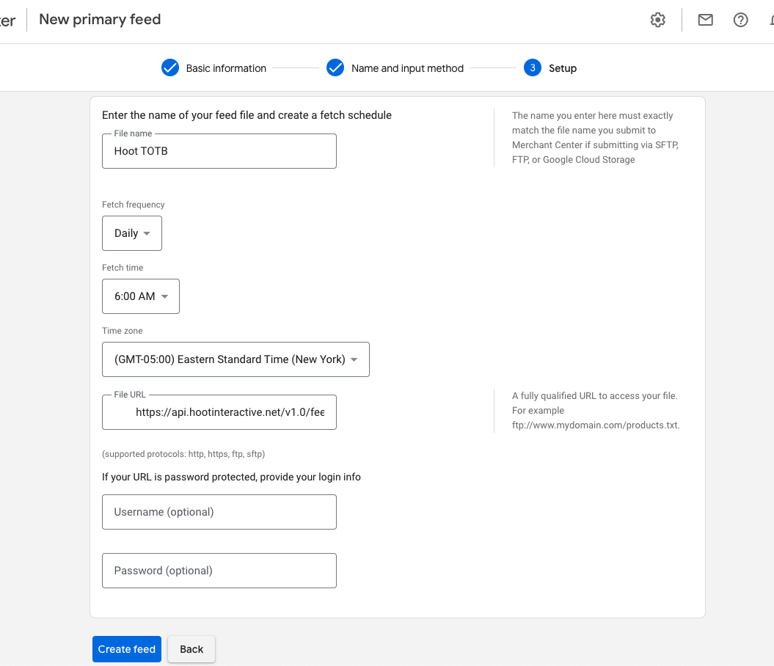
Merchant Center
Feed Creation
Give the file a name
Select frequency of feed upload
Copy and paste feed URL from Hoot Interface
Paste inside “File URL”
Username & Password not needed
Create Feed

Slide 11
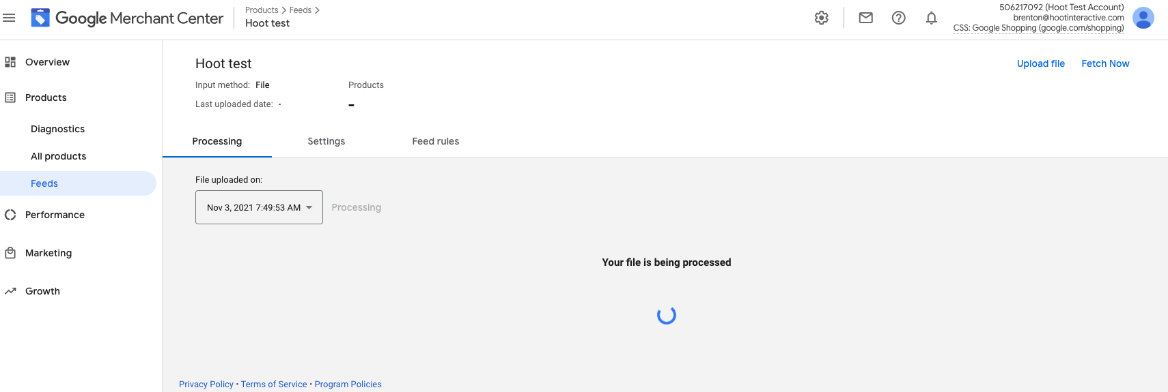
Merchant Center
Once Created click into the feed you just created
Top Right corner select “Fetch Now”
This will take a few minutes but should return some results
Fix any issues there might be present (See next Slides for details)
Vehicles missing values can be filtered out at the feed level inside the Hoot interface.
The store code parameter is required and can be applied inside the Hoot interface.
Missing or specialized attributes can be added by using feed rules inside merchant center. See here

Slide 12
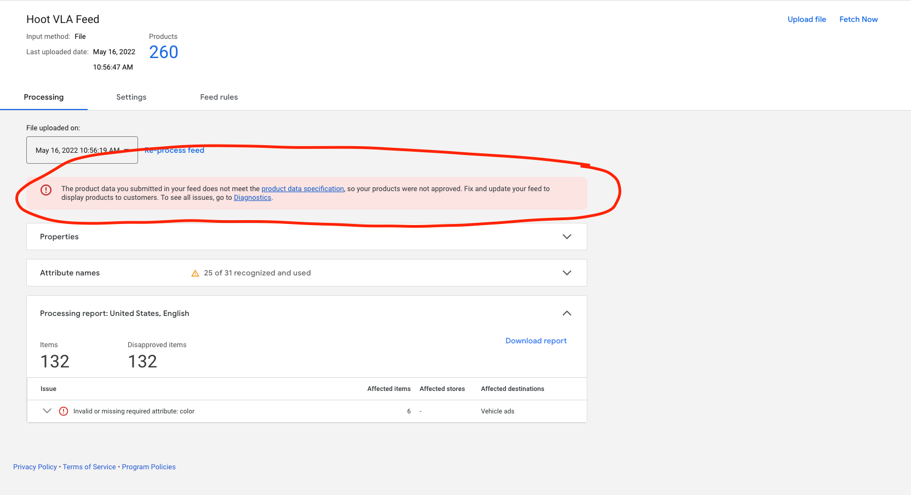
Merchant Center
DO NOT Panic If you see this
This message is misleading and no cause for alarm.
To confirm if there are any issues with the feed you must fix, please open the diagnostics tab and review the findings

Slide 13
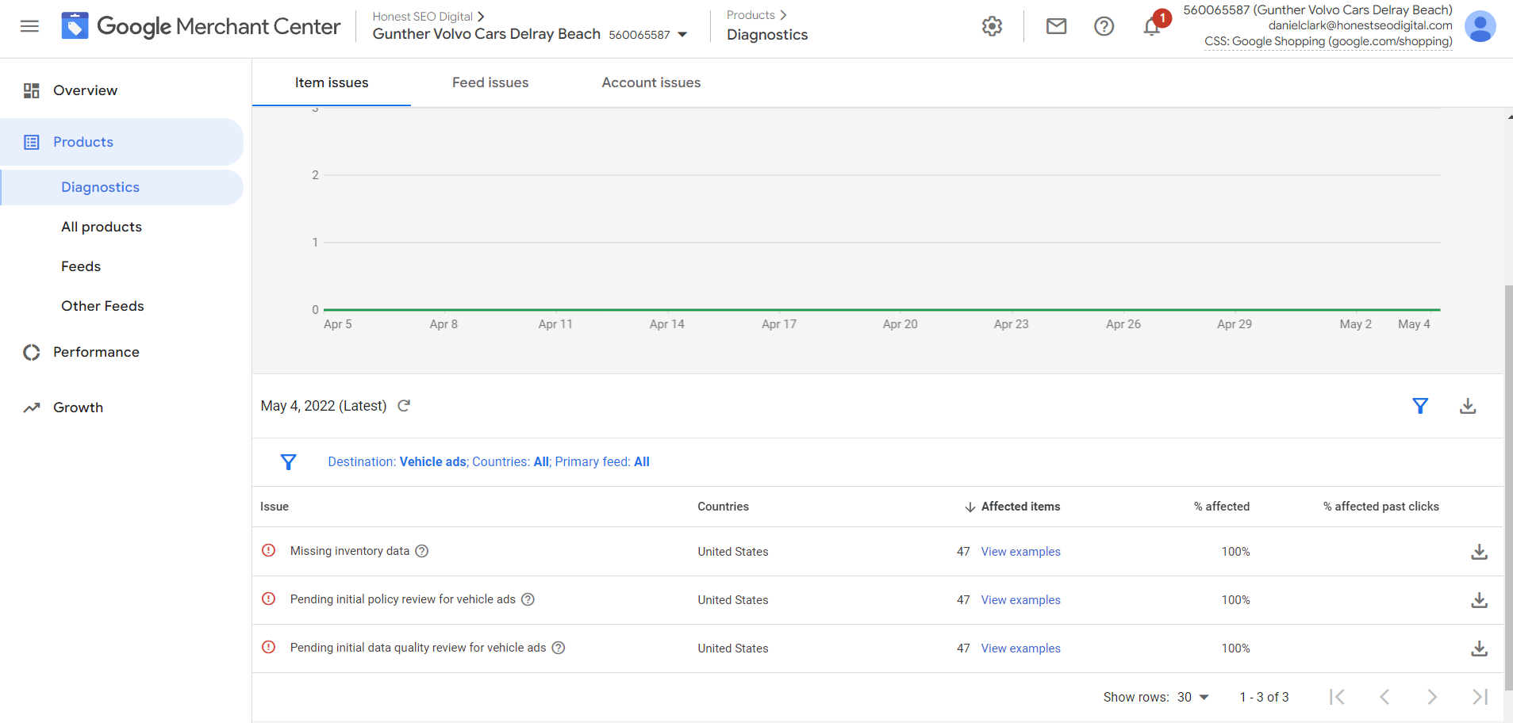
Merchant Center
What should I see upon upload?
The below errors are the initial error messages you will receive.
These indicate that Google must review the feed, perform their own scrape of the website to confirm and match inventory
Review account for accuracy and approve for the ads to run.
There is no concern with these errors you must simply wait for Google to review the upload, account details and approve.
You will most likely also see a warning for missing “links” this is usually associated to the “missing inventory data”. This message is also misleading. They are missing because Google has not approved the feed yet.

Slide 14
Merchant Center
What things do I need to fix
Here is a screenshot that includes many common upload errors.
If you note, there is an inventory count in the far right. This number identifies the number of vehicles this issue is affecting.
The ONLY error on this list that needs to be addressed is the “Invalid Store”.
The other issues are policy issues related to a specific vehicle
Please note in most cases these are issues with the website, a specific vehicle or incorrectly applying the store code. Hoot holds no responsibility in the approval or status of the VLA campaign inside Merchant Center.

Slide 15
Merchant Center
Some Important Notes about common errors:
New car mileage cannot exceed 200 miles
Used cars must have a mileage
All cars must have a price value
All cars must have a color and image link.
Please note: If the website does not contain this information, it will not be pulled into the feeds.
Store Code Trouble Shooting
Review to make sure GBP (Google Business Profile) is linked in Merchant Center, and the dealer listing is in the MC linked account and the relevant Business Group is linked as well
Review to make sure there is a store_code attribute in the VLA feed
Review to make sure there is a Store Code in the GMB listing
Review to make sure the VLA feed store_code matches the GMB listing Store Code
Make sure that there are no pending updates to the address in GMB
Uncommon: make sure the store_code doesn't have a lead '0' (eg 08662) (note there's a temporary issue with we can't ingest a store_code with a leading '0', so recommendation is to remove the leading '0')

Slide 16
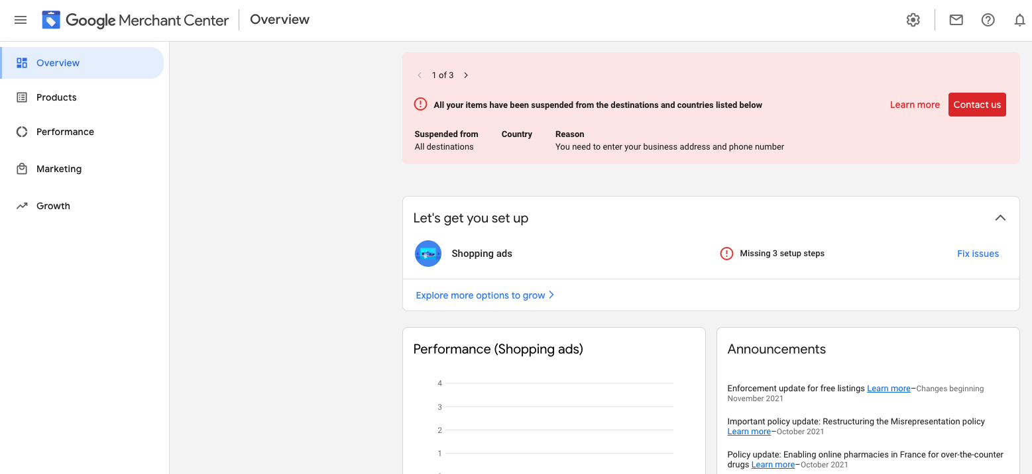
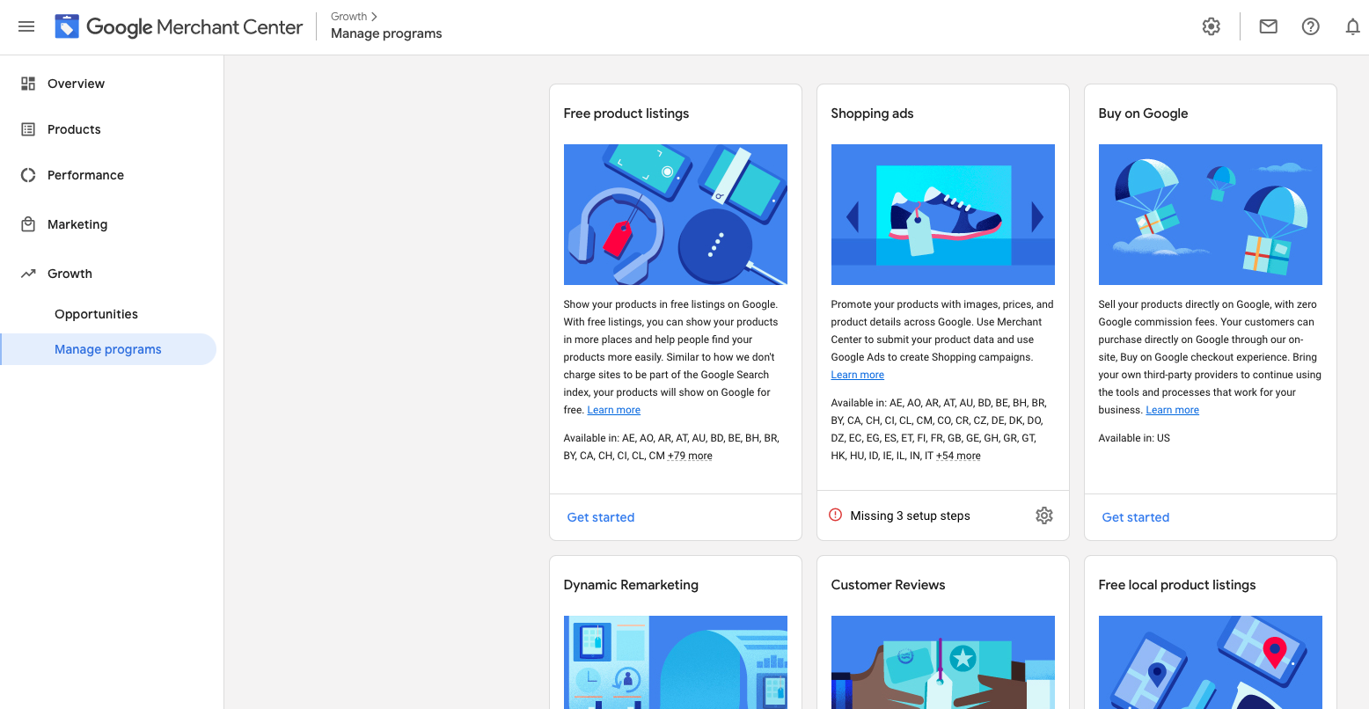
Google Merchant Center
Navigate to “Growth”
Select “Manage Programs”
Open “Vehicle Ads”

Slide 17
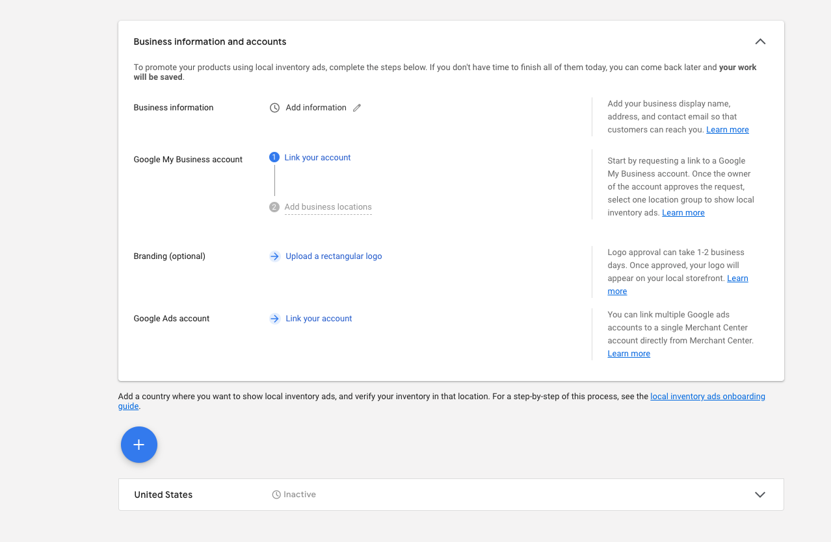
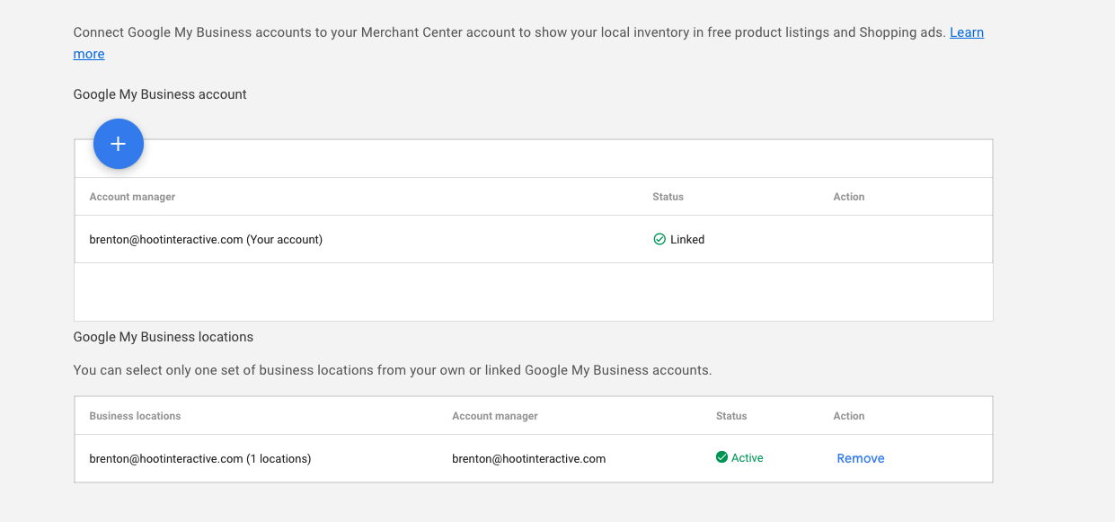
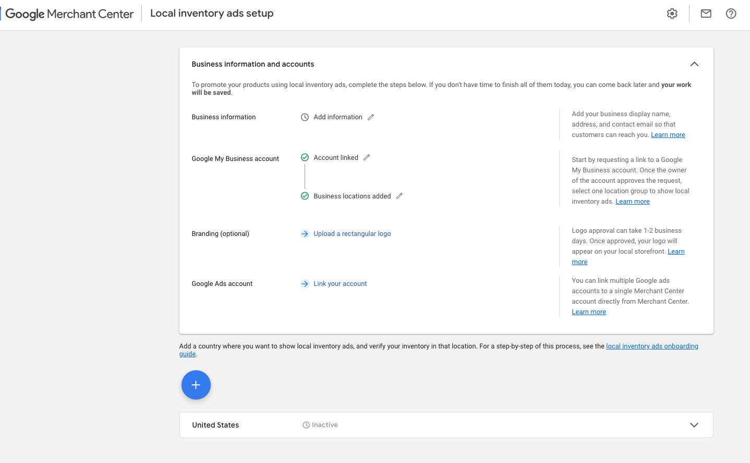
Google Merchant Center
It will ask you to pick your country
You Must Link to The Clients GMB Account
When you click into the add location it will list all locations you are set as a manager for
Select the location
Once approved, Google will show confirmation that it is now linked

Slide 18
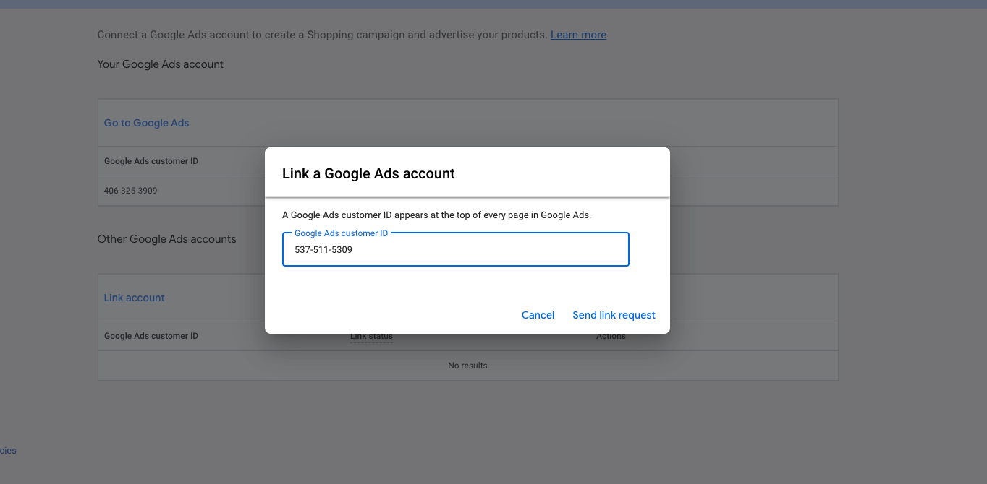
Google Merchant Center
Now You Must Link Google Ads Account
It will default to your MCC or you can add a manual request
If the account you want isn’t Shown in the tip box, open the request window under “Other Google Accounts”
Enter the CID and send request

Slide 19
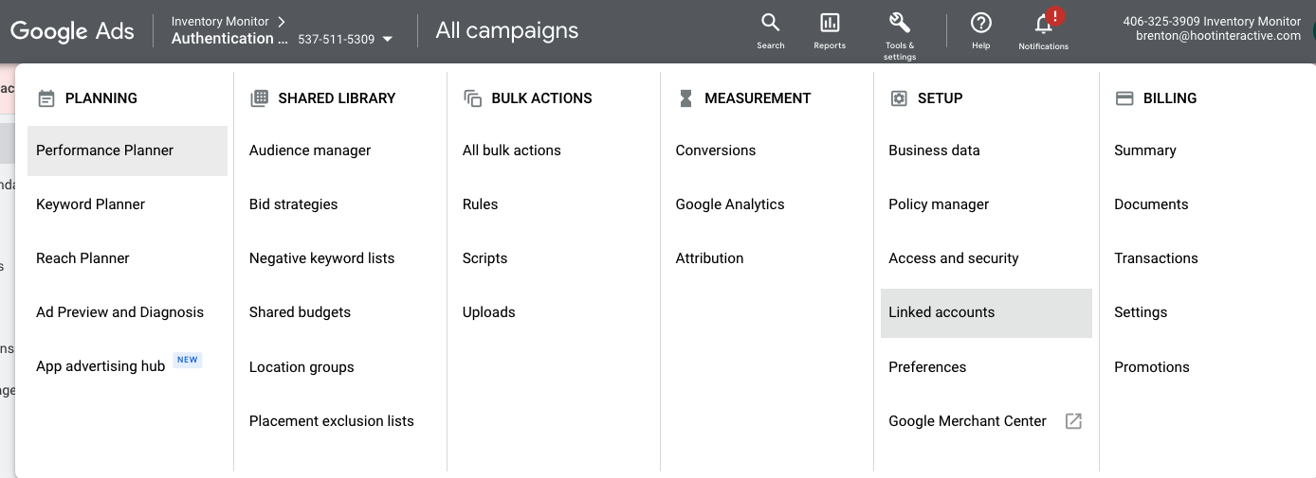
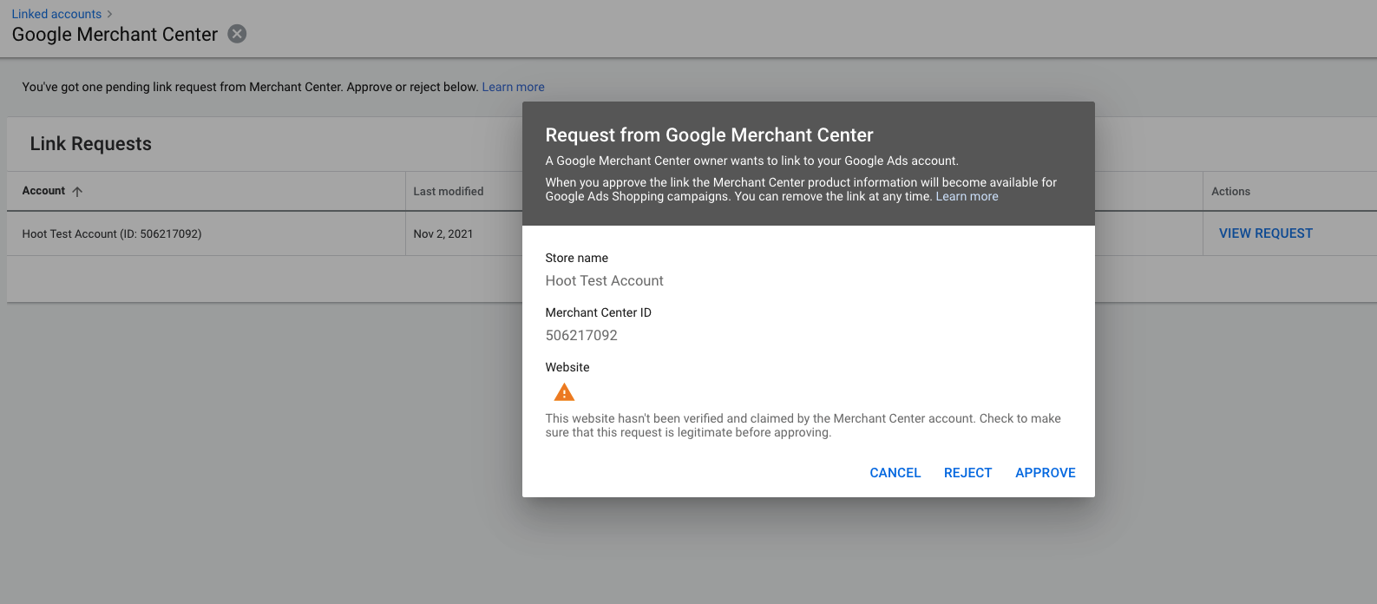
Google Merchant Center
Within Google Ads, Navigate to Tools & Settings and then “Linked Accounts”
You should see an open request
Open Request to approve
Once Approved it will show inside Google Ads as Linked

Slide 20
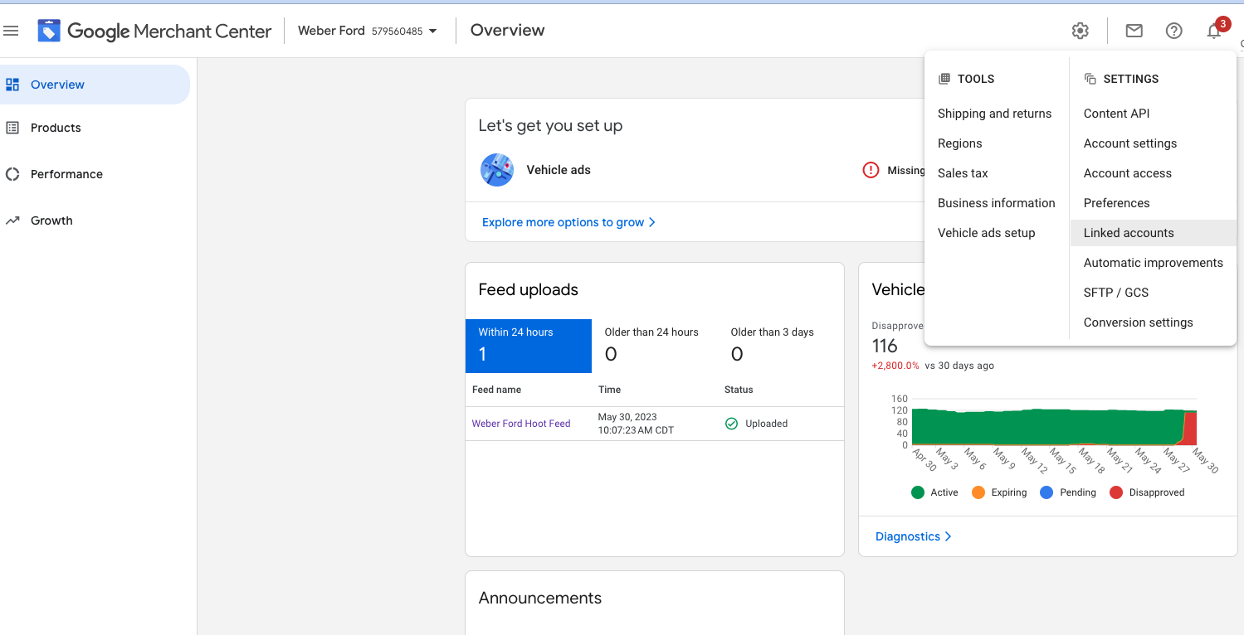
Google Merchant Center
Navigate back to Merchant Center
Navigate to the settings area and look at “Linked Accounts”
You Should see an Active link inside the Google Ads Section and Under the Business Profile
You should now see that both the GMB and ADS account are linked
There is a link to the Ads Set-up Guide just below the box
https://support.google.com/merchants/answer/3540291?hl=en
To Set Up the campaigns use the two Google links here and follow the steps inside Google Ads:
https://support.google.com/merchants/answer/11192314?hl=en&ref_topic=11189969&sjid=1029168794607185945-NA
https://support.google.com/google-ads/answer/7674740?sjid=1029168794607185945-NA

